Slide 1
Lecture 29: Blockchain Part 2

Slide 2
Outline
Public key Cryptography (Asymmetric Cryptography)
Digital Signature
Merkle Hash Tree & Merkle Root
Demo code

Slide 3
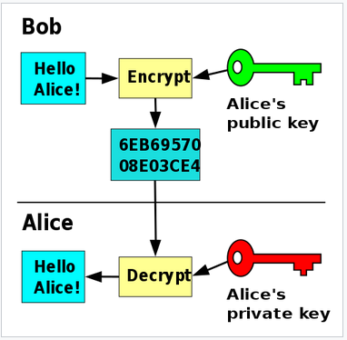
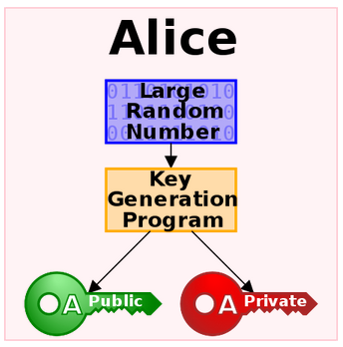
Public key Cryptography
https://en.wikipedia.org/wiki/Public-key_cryptography

Slide 4
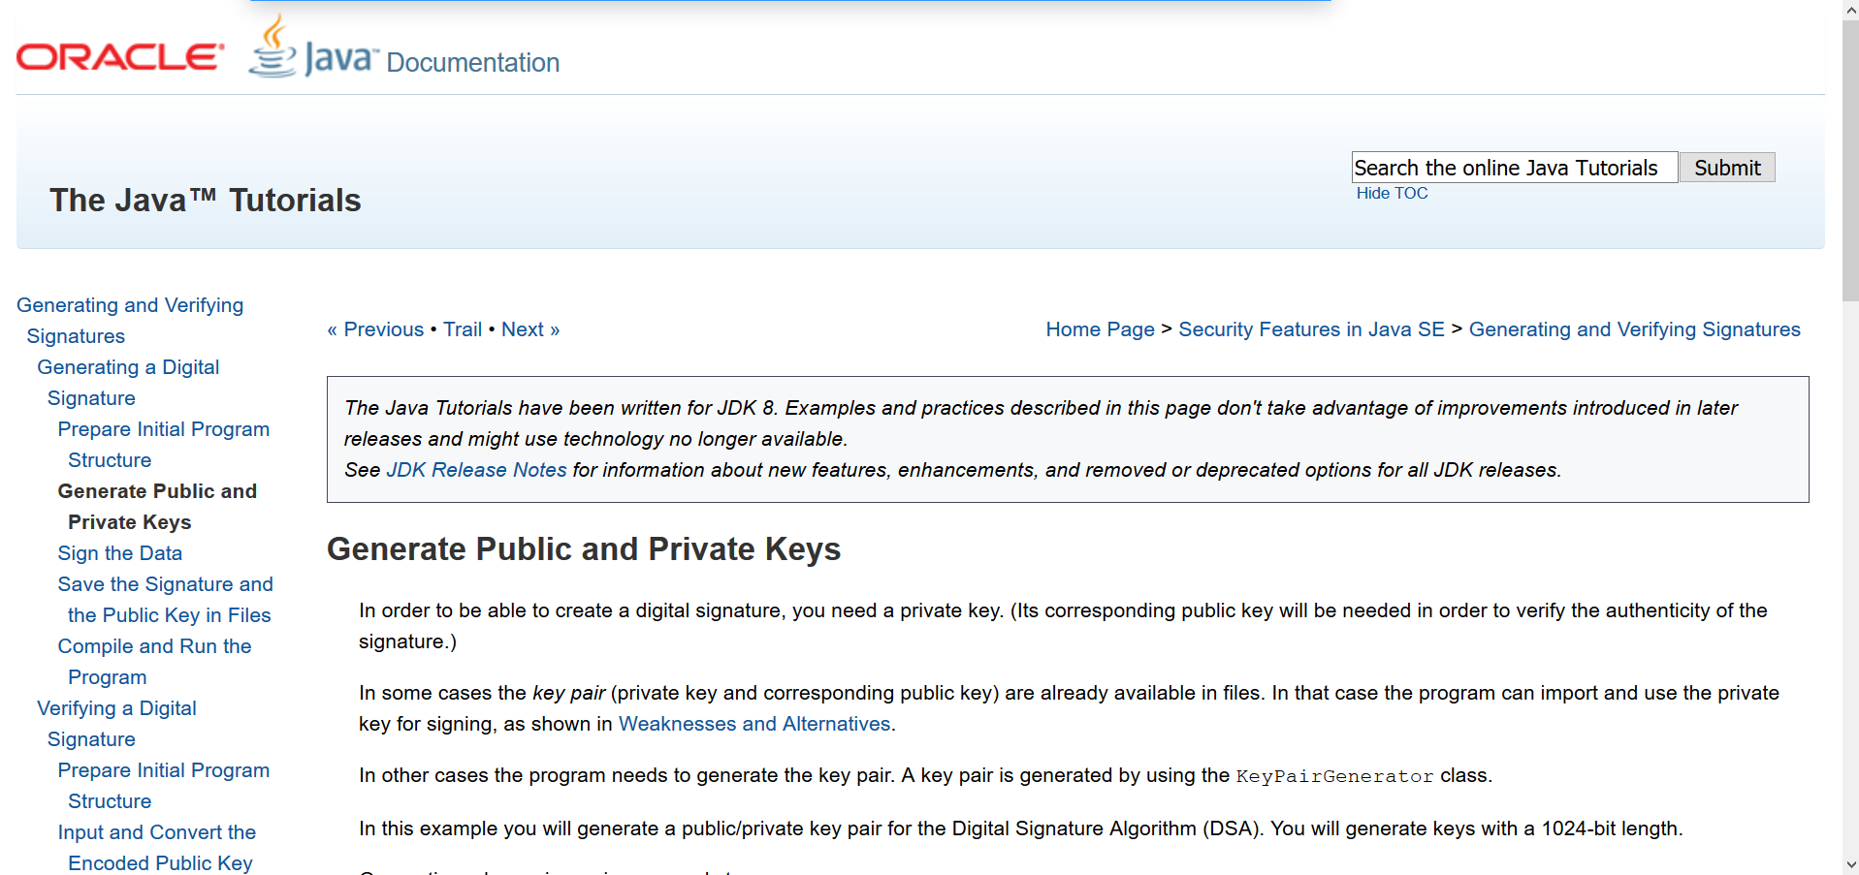
Java Resources
https://docs.oracle.com/javase/tutorial/security/apisign/step2.html

Slide 5
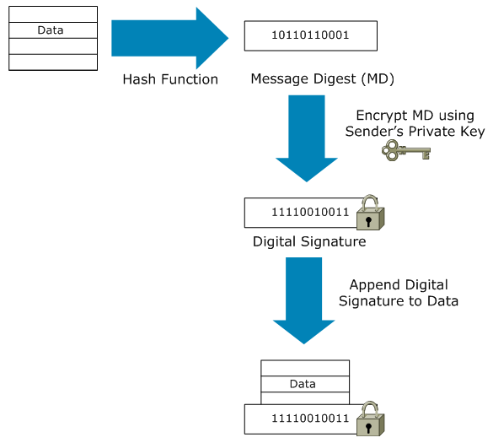
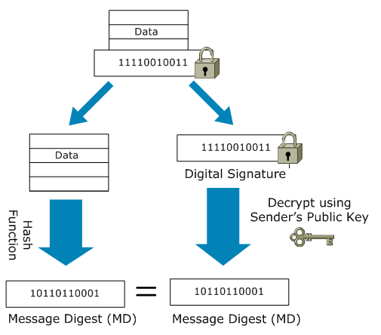
Digital Signature
Source: https://sites.google.com/site/amitsciscozone/home/security/understanding-digital-signatures

Slide 6
Demo
https://andersbrownworth.com/blockchain/public-private-keys/keys
Also See DigitalSignature.java

Slide 7
Merkle Hash Tree & Merkle Root
H_{1, 8}
(Merkle Root)
H_{1, 4}
H_{5, 8}
H_{1, 2}
H_{3, 4}
H_{5, 6}
H_{7, 8}
H₁
H₂
H₃
H₄
H₅
H₆
H₇
H₈
T₁
T₂
T₃
T₄
T₅
T₆
T₇
T₈

Slide 8
Membership Verification
H_{1, 8}
(Merkle Root)
H_{1, 4}
H_{5, 8}
H_{1, 2}
H_{3, 4}
H_{5, 6}
H_{7, 8}
H₁
H₂
H₃
H₄
H₅
H₆
H₇
H₈
T₁
T₂
T₃
T₄
T₅
T₆
T₇
T₈

Slide 9
Membership Verification…
H_{1, 8}
(Merkle Root)
H_{1, 4}
H_{5, 8}
H_{1, 2}
H_{3, 4}
H_{5, 6}
H_{7, 8}
H₁
H₂
H₃
H₄
H₅
H₆
H₇
H₈
T₁
T₂
T₃
T₄
T₅
T₆
T₇
T₈

Slide 10
Class Assignment (0.3 Bonus Points) Deadline: 22nd April (Wednesday)
Complete MerkleRoot.java to calculate the Merkle Root of the given data.

